Slide 1
Unit-1

Slide 2
Introduction
Mobile application development is the process of creating software for smart phones, tablets, and other mobile devices, involving designing, coding, and deploying apps for specific platforms like iOS (Swift/Xcode) or Android (Kotlin/Java/Android Studio), or using cross-platform tools (Flutter, React Native) to reach both; it requires focusing on user experience, performance, and device-specific features to deliver functionality from simple utilities to complex services, integrating backend support and testing thoroughly before launch.

Slide 3
Introduction
Mobile app development is rapidly growing. From retail, telecommunications and e-commerce to insurance, healthcare and government, organizations across industries must meet user expectations for real-time, convenient ways to conduct transactions and access information.
Many independent application development teams choose to build their apps for Android first. Why? The vast majority, around 70%, of smartphones run Android and the Google Play Store has fewer restrictions than the Apple App Store. On the other hand, mobile applications developed for iOS have far fewer devices that need support, making optimization simpler. And user retention is typically higher for iOS applications.

Slide 4
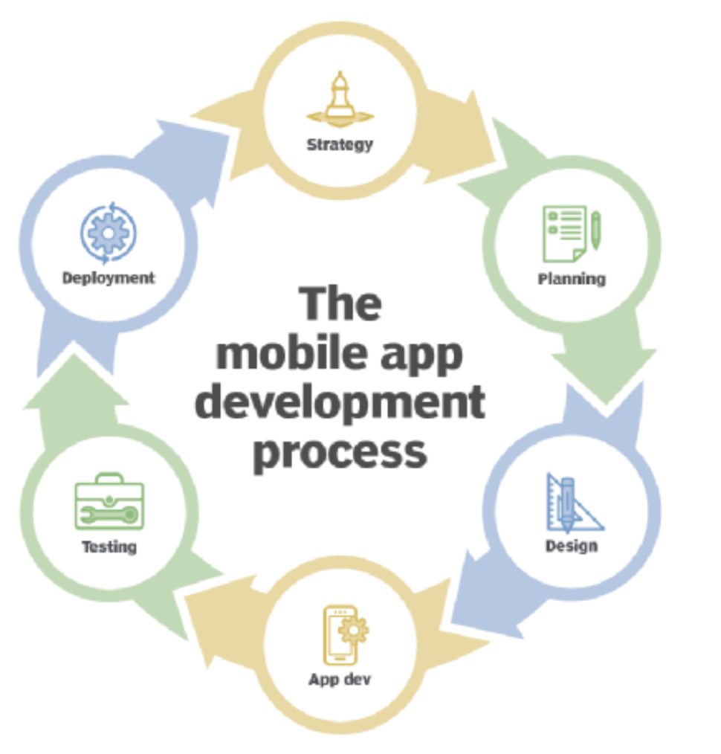
Process

Slide 5
Mobile apps are majorly developed for 3 Operating System. :
Android
IOS
Windows
There are 3 different ways to develop Mobile apps: -
1st Party Native App development
Progressive web Application
Cross-Platform Application

Slide 6
Key Concept
Platforms: Primarily Apple's iOS and Google's Android, each with its own SDK (Software Development Kit) and tools.

Slide 7
Types of Apps
Native Apps: Built for a single platform (e.g., Swift for iOS, Kotlin for Android).These types of apps normally run in the native devices, that is, it runs only in the OS that it is specifically designed for it. These apps cannot be used on different devices using a different OS.
The apps that are developed for android are normally coded using Java or Kotlin languages.
The IDE normally used for android app development is Android Studio which provides all features and the apps that are developed for IOS are generally coded in Swift language or Objective-C.
The IDE suggested for IOS App Development is XCode.

Slide 8
Advantages Native App development
The performances of these apps are very high these apps very fast compared to any other apps.
We have easy access to all the features and APIs.
The community is widespread so all your doubts and errors can be discussed and solved easily.
Updates are available on the same day.

Slide 9
Disadvantage
The development speed is too slow as we have to code it again for different OS.
And this category doesn’t support open source.

Slide 10
Progressive web Application
Progressive web apps are essentially a website which runs locally on your device. The technologies used are Microsoft Blazor, React, Angular JS, Native Script, Iconic.
These technologies normally used for web development propose. The apps’ UI is developed the same way as they are developed while developing the website.

Slide 11
Advantages of Progressive web Application:
The main advantage of this process is that its development speed is fast the same code base is used for IOS, Android, web applications.
The web development team can be repurposed to develop the mobile application.
No installation required.
Disadvantages of Progressive web Application(PWA):
The major disadvantage is that PWA don’t have access to all the feature and so the user experience is not that good IOS does not support all the features of PWA
The UI for development is bespoke i.e. the buttons, edit texts need to be programmed which was not necessary for the 1st party native Apps.
The community is not that wide spread.

Slide 12
Cross-Platform Application
These are frameworks that allow developing total native applications which have access to all the native features of IOS and Android but with the same code base. These apps run on both Android and IOS.
The performance speed is comparatively low to 1st party native apps but faster than PWA. Xamarin is Microsoft cross-platform solution that uses the programming languages like .NET, C#, F#. The IDE preferred is Visual Studio.
The UI/UX is totally native giving access to all features. whenever an update is released by Android and IOS the same updates are released by Microsoft through Visual Studio.
React Native is Facebook’s cross-platform solution which uses the language JavaScript And the preferred IDE is WebStrome & Visual Studio Code. Same like Xamarin React Native has totally native UI/UX and gives access to all features. And the updates are released the same day by Facebook as Android and IOS. Flutter is Google’s cross-platform solution which uses the language, Dart. The IDE preferred is Android Studio, IntelliJ IDE, and Visual Studio Code. The UI/UX is bespoke and Flutters has to come up with their new libraries whenever Android and IOS comes up with an update to mimic those update. The community is fast growing.

Slide 13
Advantages of Cross-Platform Application:
The apps' development speed is very high as they use the same code base for both Android and IOS.
The apps' maintenance cost is low as the errors and updates as to be countered only once.
Disadvantages of Cross-Platform Application:
Slow Code Performance With Limited Tool Availability.
Limited User Experience i.e. these apps does not have access to Native only features.

Slide 14
Mobile application development platform (MADP)
A mobile application development platform (MADP) is a type of software that allows a business to rapidly build, test and deploy mobile apps for smartphones or tablets.
An organization can either build its own mobile application development platform or buy one of the many third-party products available on the market.
MADP providers include Appzillon, Flutter, Progress Kinvey, OutSystems, Salesforce, Apple Xcode, Android Studio and Microsoft's Xamarin.

Slide 15
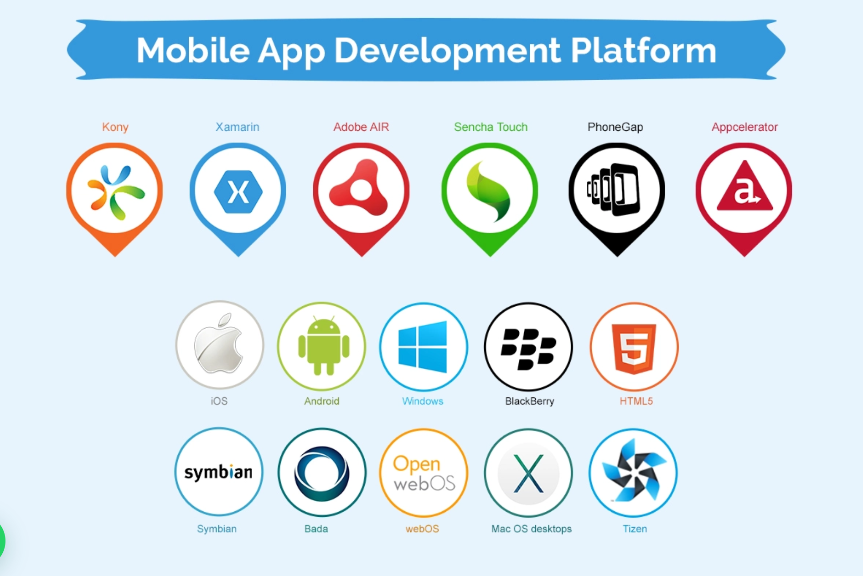
Plateform

Slide 16
Android App Development Platforms
Android Studio: Developers of Android apps should use Android Studio, Google’s official IDE (Integrated Development Environment). Has a visual layout editor, code editor, and debugging tools, among its many other capabilities.
The most recent versions of Android’s software development kits (SDKs) and application programming interfaces (APIs) may all be found within Android Studio, which is free.
Eclipse: Eclipse is also widely used for creating Android applications. Eclipse isn’t designed for Android development but provides plugins and extensions to streamline the process. Eclipse is free and can be used with several different programming languages.
Xamarin: The Xamarin platform is a cross-platform development tool that enables programmers to write apps for several platforms from a single set of source codes.
When developing native apps, Xamarin uses C# and .NET to allow for platform-specific adaptation.
React Native: To construct native apps for Android and iOS with JavaScript and React, developers frequently turn to the widely-used cross-platform development tool React Native.
With React Native, programmers can make apps that look and feel native while still reusing existing code. Among the many features and tools available in React Native are a visual designer, code editor, and debugging utilities.

Slide 17
Pros and Cons of Android app development
Large user base: Many people could use your app, making it a good investment. There are more than 2.5 billion monthly active Android users, giving app makers a huge potential audience.
Open-source platform: Android’s source code is openly shared with the world. Because of this, the operating system may be tailored to the specific demands of each developer.
Easy customisation: Android’s adaptability means the system’s UI and user experience can be modified easily.

Slide 18
Cons
Fragmentation issues: Problems with fragmentation arise because of the huge variety of Android smartphones available on the market today, each with its own screen size, resolution, and hardware specs.
Security concerns: Safety concerns can also arise from Android’s open-source nature. It’s easier for bad guys to find and exploit security flaws when the source code is open.
Compatibility issues: Although a wide variety of Android devices are available on the market, compatibility concerns may emerge during app development. This can make it harder for programmers to test their apps extensively on various devices, potentially leading to a subpar end-user experience.

Slide 19
iOS App Development Platforms
Xcode: Apple’s IDE (Integrated Development Environment) for making iOS apps is called Xcode. It has everything you need to create and debug your app, from a visual editor to a code editor and debugger.
Swift: Apple’s Swift is a new programming language made just for making iOS apps. Swift provides the power and flexibility required to build sophisticated apps while simultaneously being user- and learner-friendly.
React Native: Using JavaScript and React, React Native is a well-liked cross-platform development framework for making native apps for iOS and Android. Using React Native, developers can create native-looking apps with a unified codebase.
Xamarin: Xamarin is a cross-platform development solution that makes it easy to write apps once and deploy them on iOS, Android, and Windows.

Slide 20
Pros and Cons of iOS app development
Prons:
High-quality user experience: One of the main benefits of making an iOS app is that it provides a top-notch user experience
Consistent hardware and software: Apple’s hardware and software are tightly integrated, creating a more stable and consistent user experience.
High revenue potential: Developers have a better chance of making money from iOS customers because they spend more on apps and in-app purchases.
Cons:
Limited market share: iOS has a significant user base, but its market share is lower than Android.
Strict App Store guidelines: Developing for the App Store might be difficult due to Apple’s stringent restrictions. Before an app can be released on the App Store, it must first be reviewed by Apple and authorised based on a set of criteria relating to its design and functionality.
Higher development costs: Due to the necessity for specialised gear and software, such as a Mac computer and the Xcode IDE, iOS development is sometimes more expensive than Android development.

Slide 21
Cross-Platform App Development Platforms
React Native: As a popular cross-platform development tool, Facebook’s React Native has gained much traction in recent years. It enables programmers to use JavaScript and React to build native apps for iOS and Android.
Xamarin: Xamarin is a cross-platform development solution that makes it easy to write apps once and deploy them on iOS, Android, and Windows.
To make native apps run smoothly across several platforms, Xamarin uses C# and.NET.
Flutter: Google’s Flutter is a cross-platform development tool. Dart is a programming language used to build native iOS, Android, and web apps.
PhoneGap: PhoneGap is a cross-platform development tool that lets programmers write apps in HTML, CSS, and JavaScript and deploy them to iOS, Android, and other platforms.

Slide 22
Pros of Cross-Platform app development
Code reusability: Reusing code is a major benefit of developing for several platforms.
Faster time-to-market: Cross-platform development’s ability to allow developers to write code once and utilise it across numerous platforms means it can drastically cut the time it takes to bring an app to market.
Cost-effective: The ability to build code once and deploy it to numerous systems means that cross-platform development can save a lot of money.
Cons:
Performance issues: The cross-platform development platform must interpret the code, which can slow down the development process
Limited access to native features: Cross-platform development platforms may not have full access to native functionalities, which can reduce an app’s usefulness. Developers may need to use add-ons and plugins made by other companies to use certain capabilities.
Fewer customisation options: Cross-platform development platforms may provide fewer opportunities for personalisation than their native counterparts.

Slide 23
Cost Of mobile App Development
The cost of developing an app can vary depending on several factors, such as the app’s complexity, the platforms it will run on, and the features and functionalities required.
A basic AI-powered app, such as a chatbot or a simple image recognition tool, typically costs between $10,000 and $50,000. The main expenses for such applications include UI/UX design, API integration, and basic testing.
Development costs for mid-range AI applications that require custom machine learning models, more advanced natural language processing (NLP), or predictive analytics generally range from $50,000 to $200,000. Additionally, cloud computing services such as Amazon Web Services (AWS), Google Cloud Platform (GCP), or Microsoft Azure may be needed to handle large datasets and AI model deployments, adding additional server costs and scaling expenses.
A highly advanced AI app with deep learning, real-time processing, or sophisticated automation can cost between $200,000 and $500,000+. These applications often involve extensive R&D, ongoing model improvements, and large-scale infrastructure support. AI-powered healthcare, finance, or autonomous applications ,require high precision, compliance with regulations, and continuous maintenance, all driving up costs.

Slide 24
Factor
What are the Cost Factors for Building a Mobile App in 2026?
Cost category | Description | Typical range (USD)
Discovery and planning | Market research, UI/UX wireframes, feature mapping | $640–$4,500
App design and prototype | Interface design, branding, and mock-ups | $1,280–$9,000
Front-end and back-end development | Core coding and feature implementation | $6,400–$56,000
Third-party integrations and APIs | Payment gateways, analytics, maps, etc. | $640–$4,200
Testing and quality assurance | Manual and automated testing, debugging | $960–$9,000
Post-launch maintenance | Bug fixes, updates, scalability improvements | $160–$4,500/month

Slide 25
App type
Social media apps: such as Facebook, Instagram, and Twitter.
E-commerce apps: such as Amazon, Sephora, and eBay.
Gaming apps: such as PUBG Mobile, Among Us, and Candy Crush Saga.
Education apps: such as Duolingo, Coursera, and Udemy.
Healthcare and fitness apps: such as ZocDoc, Medscape, and MyFitnessPal.
Travel apps: such as Airbnb, TripAdvisor, and Google Maps.
Productivity apps: such as Trello, Evernote, and Asana.
On-demand apps: such as Uber, Lyft, and Postmates.

Slide 26
Estimated time and cost
App Type | Estimated Time to Develop | Estimated Cost
Social Media | 6-12 months | $50,000-$500,000
E-commerce | 4-12 months | $30,000-$500,000
Gaming | 2-12 months or more | $10,000-$500,000 or more
Education | 3-6 months | $25,000-$250,000
Health and Fitness | 4-6 months | $50,000-$250,000
Travel and Hospitality | 3-8 months | $25,000-$300,000
Productivity | 3-6 months | $25,000-$250,000
On-demand | 4-8 months | $50,000-$300,000

Slide 27
Myth of mobile Application: Common Myths
App development is cheap and fast.
More features make a better app.
The job is done after launch.
Marketing isn't necessary.
You only need to build for iOS or Android
Security can wait until later:
An app is only for B2C (Business-to-Consumer). Reality: B2B (Business-to-Business) apps can be highly profitable and useful.
Myth: In-house development is the only way.

Slide 28
Benefits of Mobile app for Business
1. Increased Sale and profits: The goal of any business is to have more sales and increased profit. Whether you are a restaurant, gym, retailer, or you have any other business,
2. Simplified buying experience: Purchases have become so much easier with the launch of e-commerce websites. Instead of having to go to a physical store, customers can browse products online with just a computer from the comfort of their homes.
3. Product navigation and payment: Mobile apps encourage customers to make purchases as apps are easier to navigate than websites. Payments over phone are also convenient and faster. 4. Communication: An app helps connect a business with its customers mainly via push notification feature. It can alert customers to new offers and products available. Direct messaging also helps communicate with the customer by answering any questions they may have about the product they are considering buying.
5. Data Collection: Gather valuable insights into customer behavior to refine strategies and personalize experiences.

Slide 29
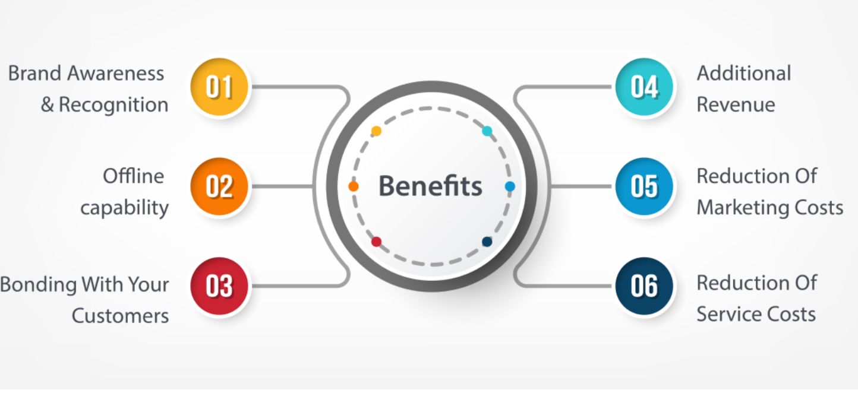

Slide 30
Mobile User Interface Design
Effective mobile UI design maximizes limited screen space through simplicity, clear visuals, and intuitive navigation, requiring deep understanding of users' context, needs, and platform-specific behaviors.
Using the screen real estate efficiently
How the user perceives design elements
Social aspect of mobile interfaces
Accessibility
Design patterns
Designing for the platforms

Slide 31
Effective use of screen and estate
Prioritize Content: Display only essential information and actions, using visual hierarchy to guide the user's eye.
Simplify Navigation: Use familiar patterns like tabs, bottom navigation, or hamburger menus, keeping them accessible and consistent.
Whitespace: Utilize negative space effectively to reduce clutter and improve readability, making elements stand out.
Legible Typography: Choose clear, sans-serif fonts with sufficient size and weight, avoiding overly decorative or thin fonts.
Minimize Text: Rely on clear icons with comprehensible symbols or concise labels where necessary, as text takes up valuable space

Slide 32
Understanding Mobile Users & Context
Small Screens & Touch Targets: Design large enough touch targets (buttons, links) for fingers, acknowledging the limitations of small screens.
Context Awareness: Consider how users interact (on the go, distracted), their environment (bandwidth, lighting), and their primary goals.
Platform Conventions: Adhere to iOS (Human Interface Guidelines) and Android (Material Design) standards for native feel, making apps intuitive for platform users.
Minimize Input: Reduce typing by using smart defaults, auto-fill, and simple selections; data entry is harder on mobile.
Accessibility: Design for users with low vision or motor impairments by ensuring high contrast, clear text, and easy interaction.

Slide 33
Accessibility to differently –abled user
High Contrast & Resizable Text: Ensure strong contrast, support dynamic type/font scaling, and avoid embedding text in images.
Screen Readers: Use proper labels, semantic HTML, and group interactive elements for easier navigation by screen readers.
Color Blindness: Don't rely on color alone to convey information; use icons or text too.

Slide 34
Understanding Mobile information design
Prioritize Content & Clarity: Display essential information first, using whitespace and clear visual hierarchy; avoid clutter.
Optimize for Touch: Ensure buttons and interactive elements are large enough (min 44x44pt) for easy tapping, preventing misclicks.
Simplify Navigation: Use standard patterns (tabs, hamburger menus) and clearly labeled icons to help users find their way.
Maintain Consistency: Follow platform-specific (iOS/Android) design guidelines for a familiar feel and predictable behavior.
Reduce Cognitive Load: Keep designs clean, use concise language, and offer informative feedback to make interactions effortless.
Design for Context: Consider how users interact on the go (one-handed use, distractions).

Slide 35
Thank you

